Slide 1
Comparison - Thiruvanathapuram & Kochi
Data Science Capstone Project
Hareesh Bhargavan

Slide 2
Introduction
This project is compare and contrast between the neighborhood characteristics of the two major cities viz, Thiruvananthapuram (Trivandrum) and Kochi (Cochin) of the state of Kerala in India.
Historically Keralites have migrated to the four corners of the world. With Covid 19 world over the current trend is to work from home and for many Keralite expartiates reverse migration is very much on the cards.
This study is intended to analyse similarities and differences between the two major cities of Kerala, for expatriates who intend to return and settle back home in Kerala.

Slide 3
Data
Data required are the list of suburbs of both these cities, latitude and longitude of each of these suburbs and foursquare data to corresponding to these coordinates.
The lists of suburbs of both the cities are taken from Wikipedia and their latitude and longitude are downloaded using geocorders.
Details of venues for each suburb is downloaded from foursquare.

Slide 4
Methodology
List of suburbs obtained from Wikipedia was cleaned for availability of location coordinates.
Clustering comparison is used for the suburbs of both cities using Kmeans clustering algorithm to identify differences in characteristics based on venues.
Multiple attempts were done at clustering by varying the number of venues and number of clusters to arrive at the optimal number of clusters.
Folium library is used to plot maps.
Matplotlib is used to plot histograms.

Slide 5
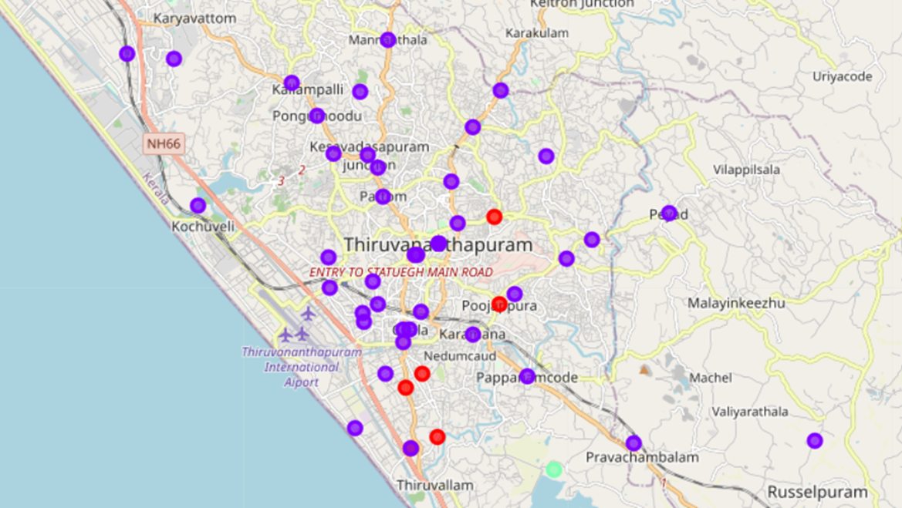
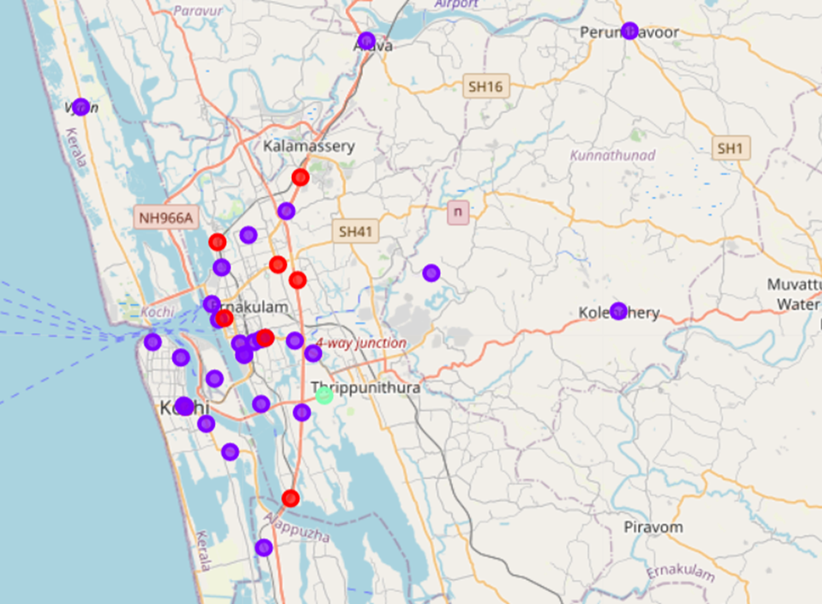
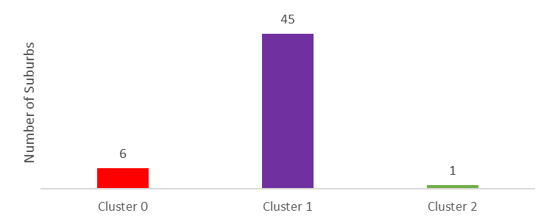
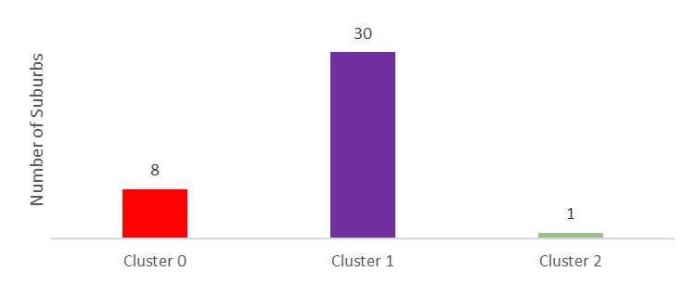
Methodology – Kmeans …………..1
Thiruvananthapuram
Kochi

Slide 6
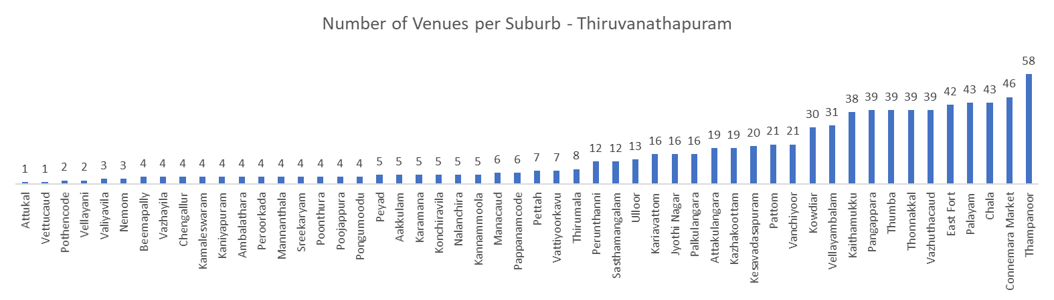
Methodology – number of venues ……… 1
There are 52 suburbs in Thiruvanathapuram
Number of venues range from 1 to 58

Slide 7
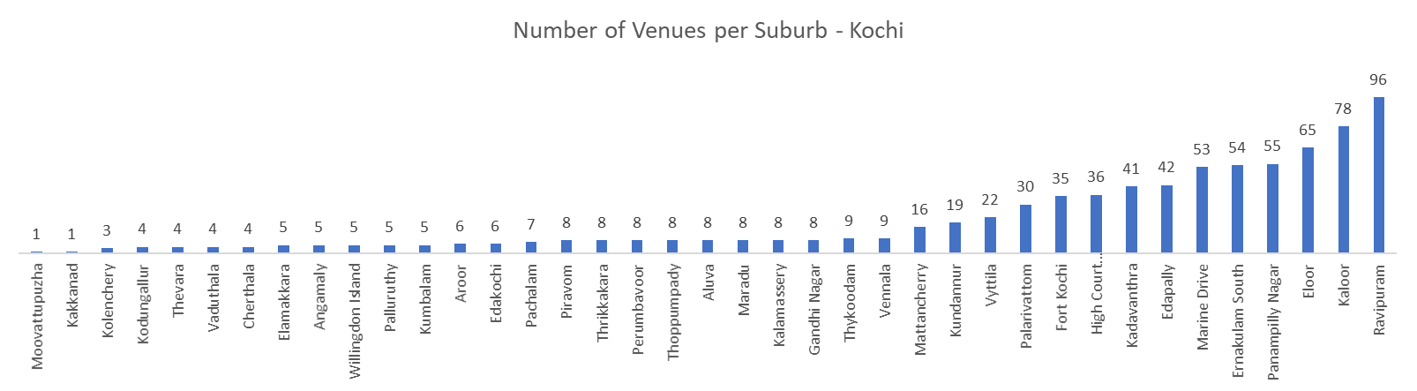
Methodology – number of venues ……… 2
There are 39 suburbs in Kochi
Number of venues range from 1 to 96

Slide 8
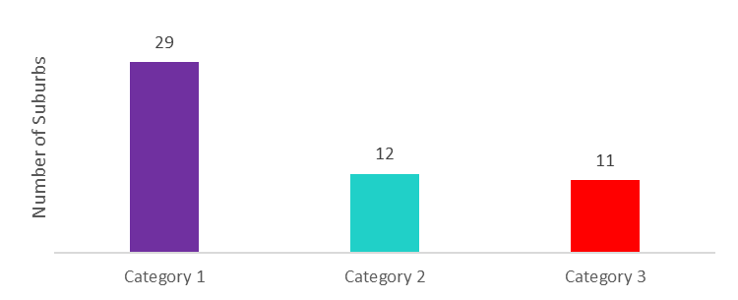
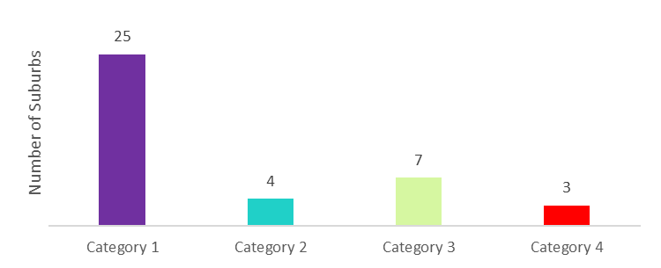
Methodology – number of venues ……… 3
Thiruvananthapuram
Kochi
Category 1 Less than 10 venues
Category 2 11 to 30 venues
Category 3 31 to 60 venues
Category 4 More than 60 venues
Category 1 Less than 10 venues
Category 2 11 to 30 venues
Category 3 31 to 60 venues
There are more number of suburbs in Thiruvananthapuram in Categories 1, 2 & 3.
Category 4 suburbs are there only in Kochi.

Slide 9
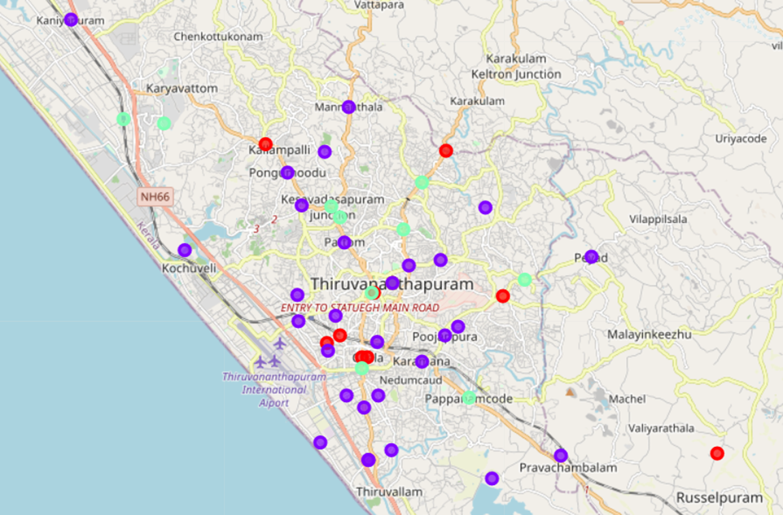
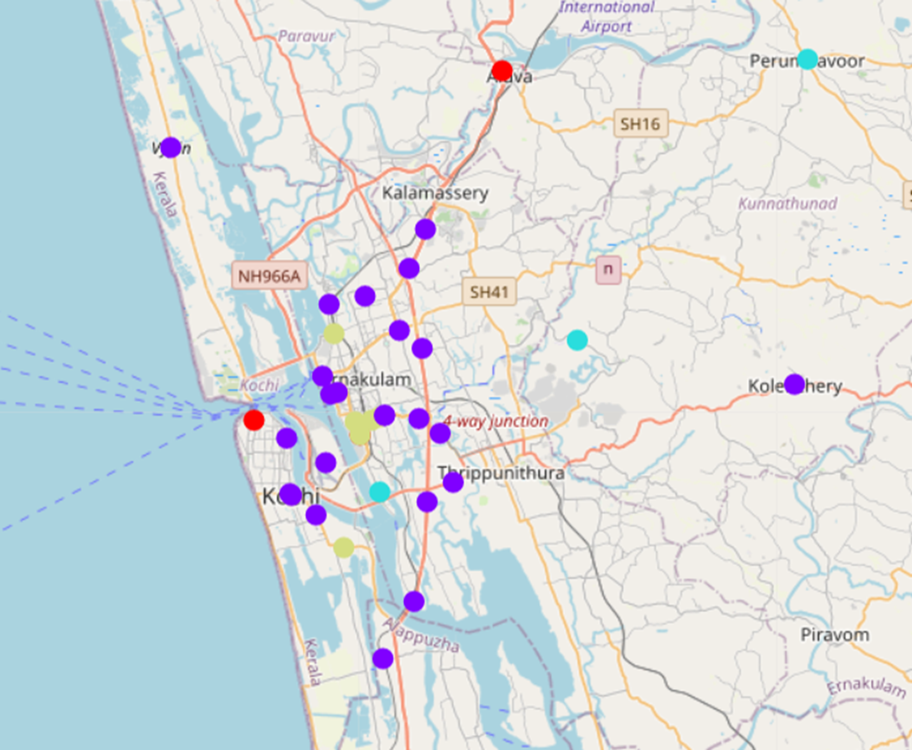
Results
Thiruvananthapuram
Kochi
Less than 10 venues
11 to 30 venues
31 to 60 venues
Less than 10 venues
11 to 30 venues
31 to 60 venues
Above 60 venues
Number of suburbs are more in Thiruvanathapuram compared to Kochi.
Density of venues per suburb is higher in Kochi compared to Thiruvanathapuram.

Slide 10
Results
Clustering analysis identifies 3 types of clusters in each city.
Histograms based on number of venues per suburb identifies the following distinguishing characteristics.
Number of suburbs are more in Thiruvanathapuram compared to Kochi.
Density of venues per suburb is higher in Kochi compared to Thiruvanathapuram.

Slide 11
Discussion
This is a preliminary analysis based on number venues per suburb.
Result here indicates Thiruvananthapuram to be more spread out with a relatively lower density of venues per suburbs compared to Kochi.
More extensive analysis can be performed incorporating other factors like real estate prices, proximity to roads, population etc.

Slide 12
Conclusion
Preliminary analysis based on foursquare data indicates Thiruvananthapuram to be more spread out with a relatively lower density of venues per suburbs compared to Kochi.
More extensive analysis can be performed comparing the two cities incorporating more dimensions and parameters.

